Slide 1
Animal Farm Notes
8th Grade Pre-AP ELA BY: Tyler Harris

Slide 2
Setting of the Novel
All Real places in Real life they have just been skewed (changed)
Where: rural (country) England
  Village of Willingdon
  Farm: Manor Farm
  In Real Life: 1917 WWI—in order to help the war effort the UK Govt. had farmers turn pasture land for animals into farm land—upset b/c these men had never grown food b4

Slide 3
Time Period of the Novel:
  Novel is Published 1946 story takes place before that…1917-20’s
  Set in British Countryside however it is inspired by Russian Revolution and the start of the Soviet Union
    Events at Manor Farm are Allegory for this
  1917 Russian Aristocracy (Romanoff's) was overthrown by the people of Russia, lasted till 1922
    Created hope for working-class until…
      Joseph Stalin- Tyrannical, Dictator who took an idea that many believed to be equality to a life of Turmoil and Terror
On the next 2 slides is a scene from Anastasia showing the demise of the Romanoff’s during the Russian Revolution

Slide 4
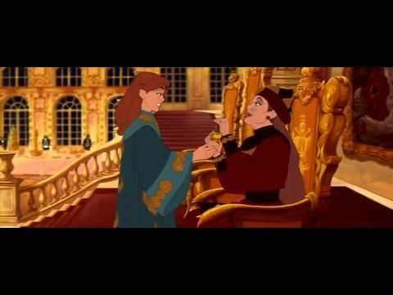

Slide 5
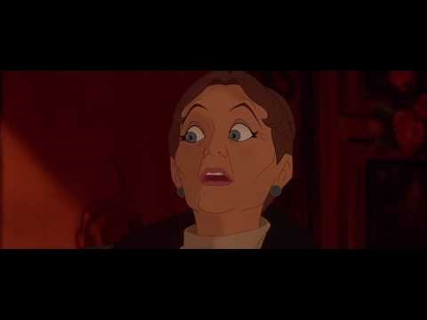

Slide 6
Animals of Animal Farm: Inspired by Historical Figures
Old Major: Karl Marx and Vladimir Lenin
  wise, old boar
  near the end of his life
  rallies animals to rebel but wants them to stay away from human vices (sins)

Slide 7
Napolean: Based on Joseph Stalin
  leads rebellion against animal oppressors
  corrupted by hunger for power
Snowball: Based on Leon Trotsky
  jockeys for power against Napolean
  has farms best interest in mind

Slide 8
Mr. Jones: Tsar and ruling elite who were overthrown in the Russian Revolution
Other Characters in novel represent aspects of Russian Society at time of rebellion
Boxer: workers of Russia
  humble, honest
  portrayed as a Horse
  works harder and longer than anyone else on farm; will sacrifice his health for this

Slide 9
Squealer: Propagandist (uses images and words to convince people to their way of thinking)
  spreads misinformation around farm
  convinces other animals Napoleon is always right

